Slide 1

Info6150 final project presentation
HELPING HANDS
Noordeep Singh Gill - 002194664 - gill.no@northeastern.edu
Naman Gupta - 002142933 - gupta.nama@northeastern.edu
Kiran Unnikrishnan - 002101654 - unnikrishnan.ki@northeastern.edu
Siddhartha Savant - 001568075 - savant.si@northeastern.edu

Slide 2
purpose
Our application bridges the difference between the NGO and donors by creating a platform to aggregate all NGO where the NGO can raise requests for donation. The donors can view these requests and respond to them.
The donors can also schedule a visit to the NGO. The visit requests can then be approved or rejected by the NGO.
The website has a lot of features like creating user account, managing user account, NGO’s can raise request for donation, donors can donate and raise a request to visit the NGO, NGO can review visit requests.

Slide 3
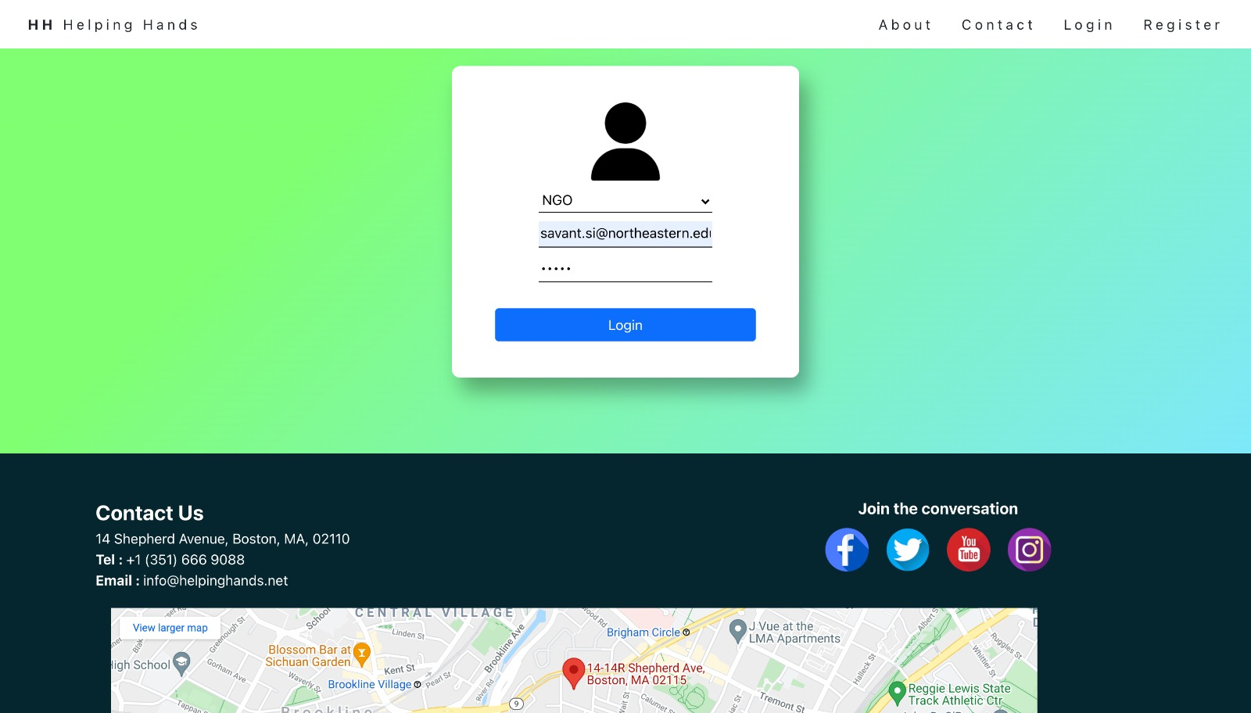

Slide 4
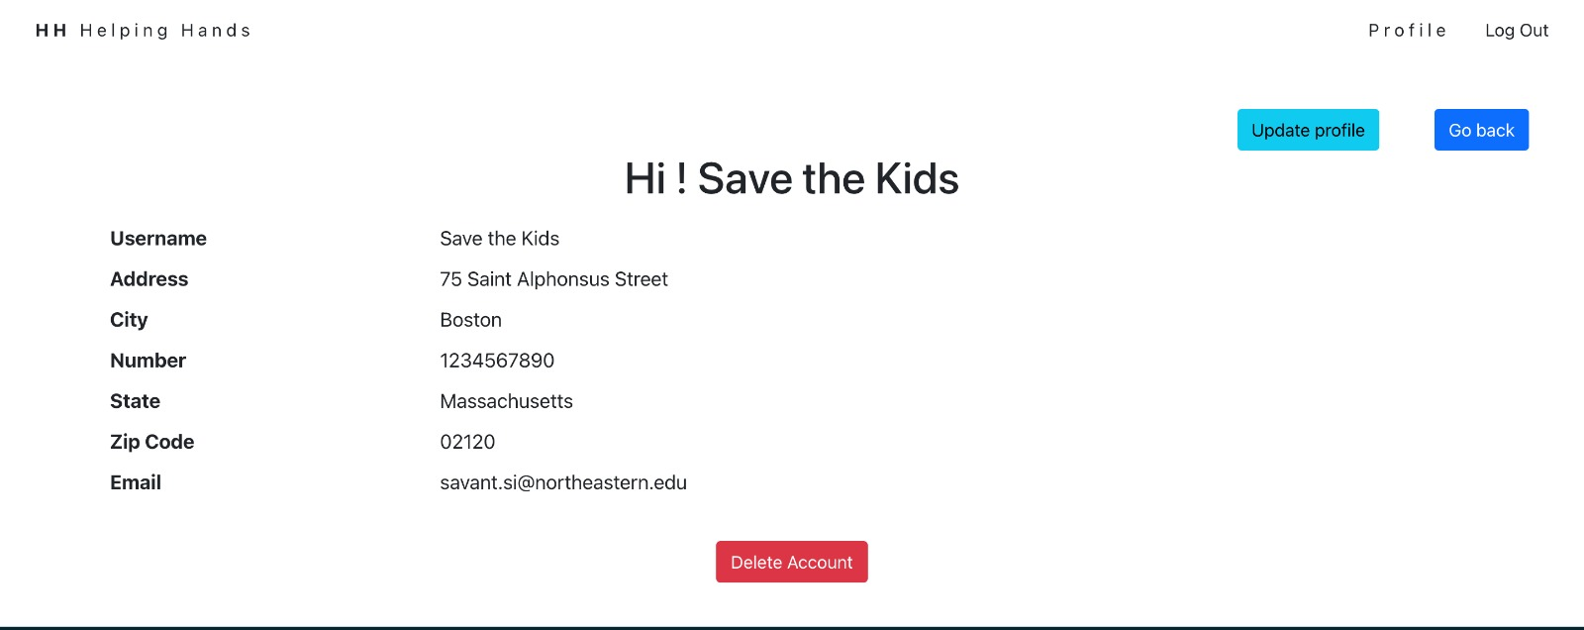

Slide 5
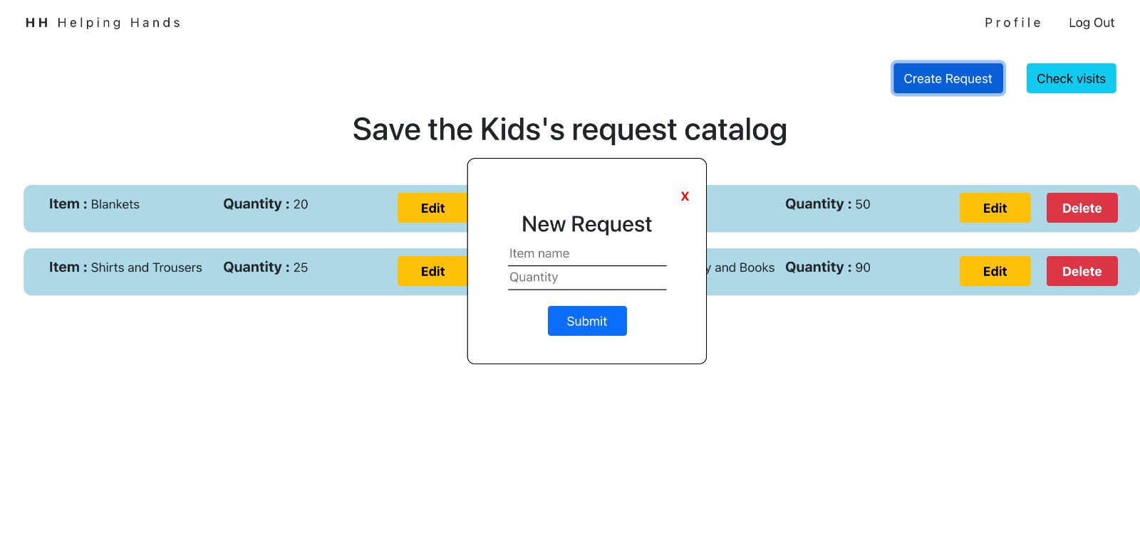

Slide 6
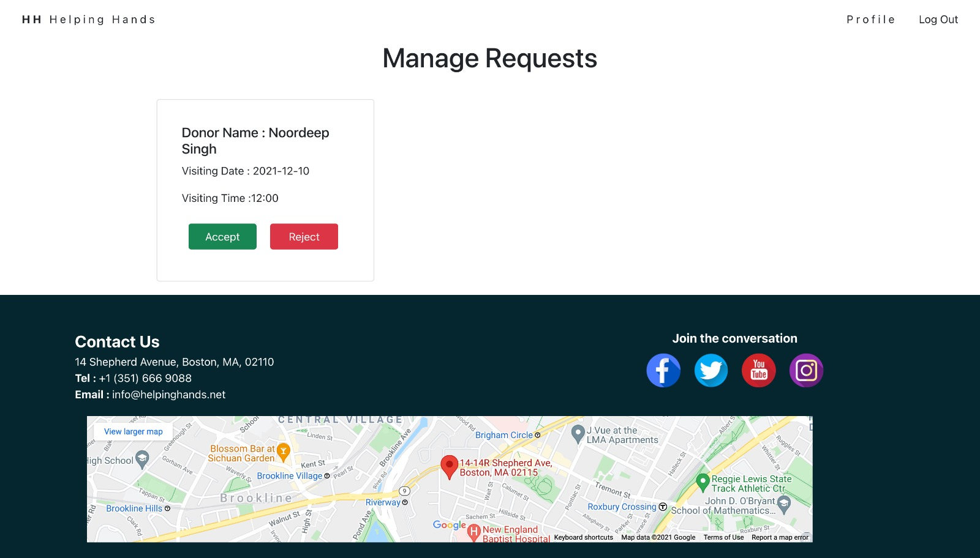

Slide 7
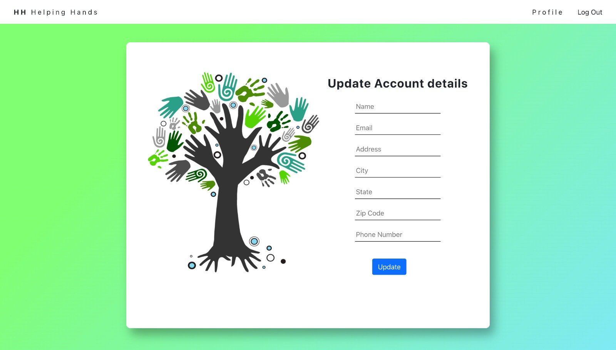

Slide 8
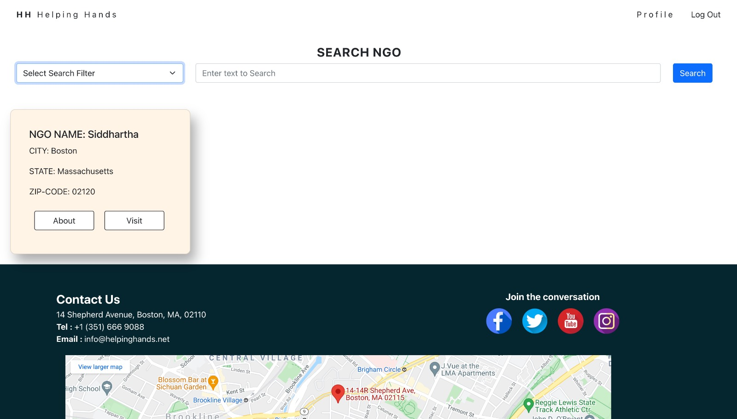

Slide 9
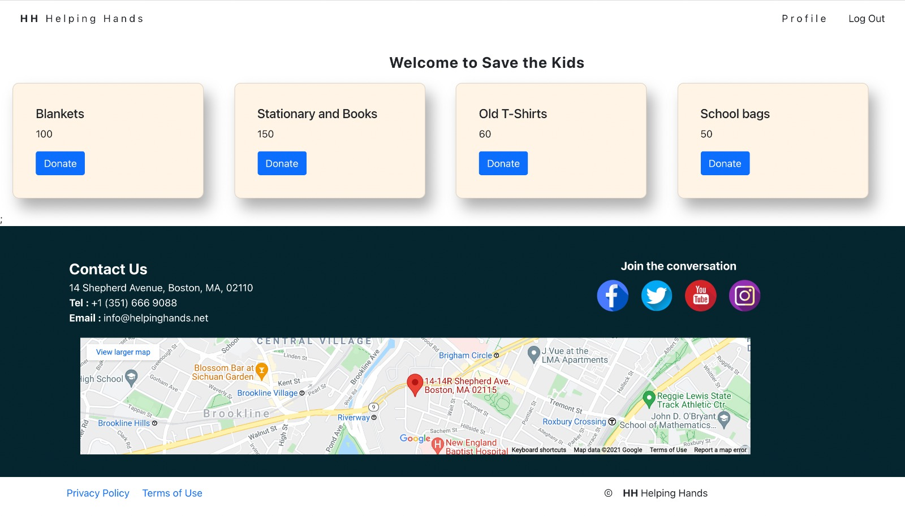

Slide 10
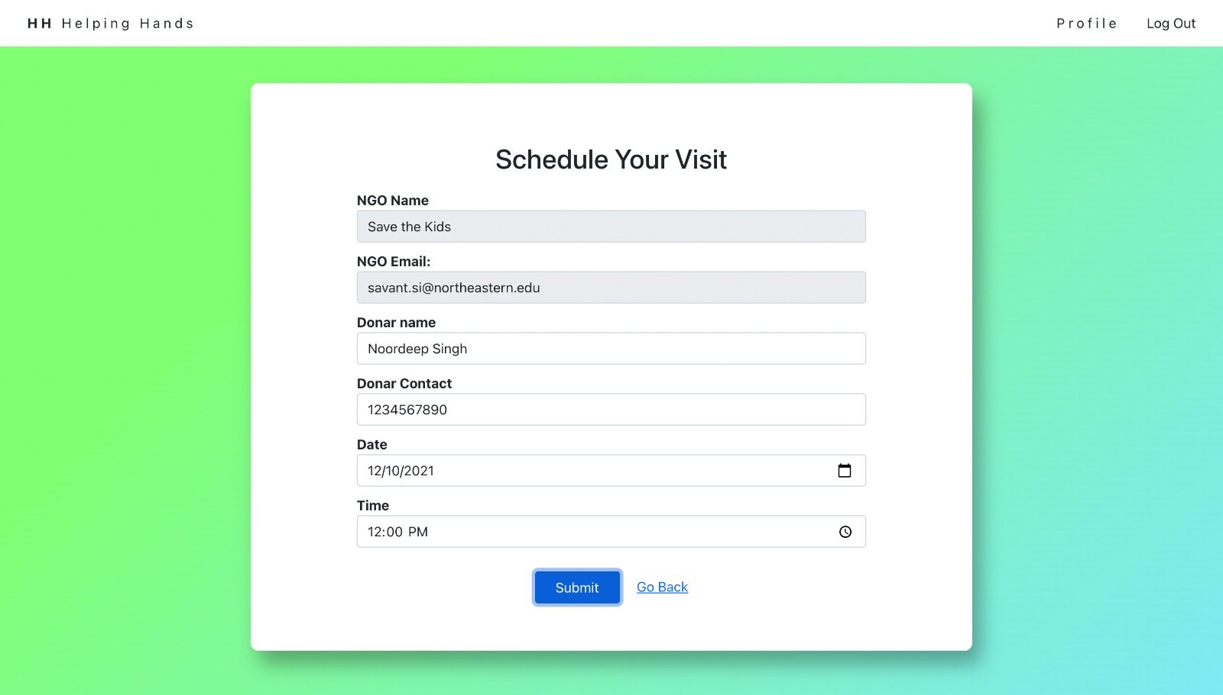

Slide 11
Team member contribution
Noordeep : Registration of Donor and NGO functionality completed,
Creation of NGO request, deletion of NGO request, updation of NGO request
Schedule visit to NGO functionality added, deactivation of User Account (NGO & Donor)
Contact US UI, Login page UI, Navbar UI, NGO UI, Update profile UI, footer UI, Contact Us footer UI
Kiran : Worked on the search bar component, Login Page UI, card layout component for displaying search results, implemented manage visits page for NGO ,NGO visit CRUD operations, Created routing for HTTP calls from frontend
Siddhartha : Main page UI and Navbar functionality, Donor CRUD operations, Display and delete NGO requests,
About Page UI, Used jwt token for token verification and Implemented Nodemailer for email verification
Naman : Worked on the backend of the application. Implemented JWT token, Password hashing, and authentication of user when he logs in, Checking if user already has account, Created routing for HTTP calls from frontend to backend, Added loader and error to display it on screen, Implemented Schedule visit page

Slide 12
THANK YOU

